Slide 1
What are molecules?
Small generic structures
A warehouse for building models
Common heritage of
SDers

Slide 2
Where are molecules
Models of molecule
https://exchange.iseesystems.com/models/
player/jimhines/molecules
Documentation of molecules
https://sdmolecules.org

Slide 3
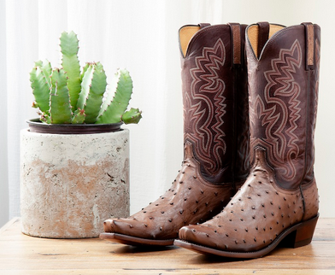

Slide 4
Inventory
0
weeks
100
Workers
0
weeks
100

Slide 6
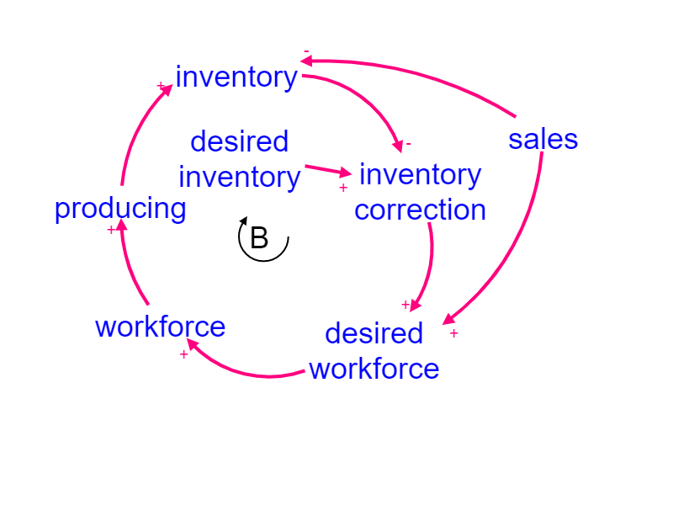
Bathtub

Slide 7
Bathtub
Building
Inventory by doing work

Slide 8
Bathtub
Building
Inventory by doing work
Close Gap

Slide 9
Bathtub
Building
Inventory by doing work
Close Gap
Workforce

Slide 10
Bathtub
Building
Inventory by doing work
Close Gap
Workforce FromWorkflow
Workforce

Slide 11
Bathtub
Building
Inventory by doing work
Close Gap
Workforce FromWorkflow
Workforce

