Slide 1
the presentation will begin shortly…
isee systems inc | (603) 448-4990 | www.iseesystems.com
Wheelock Office Park | 31 Old Etna Rd, Suite 7N | Lebanon, NH 03766 | US

Slide 2
Presented by Billy Schoenberg | October 16, 2024
isee systems inc | (603) 448-4990 | www.iseesystems.com
Wheelock Office Park | 31 Old Etna Rd, Suite 7N | Lebanon, NH 03766 | US

Slide 3
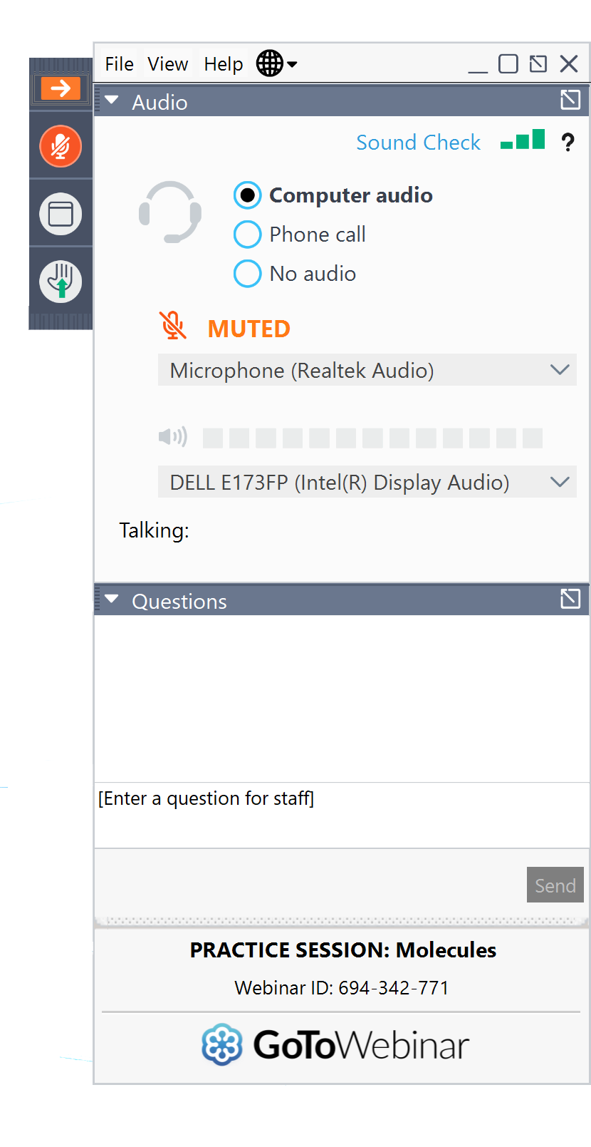
Webinar mechanics
Grab tab
Enables you to hide or display control panel and toggle between full-screen and window mode
Audio setup
Allows you to test your audio
Also make sure your volume is turned up and your speakers are not muted.
Questions
Submit your questions here at anytime during the Webinar

Slide 4
Today’s Topics
1. What is LTM? What is it for? How does it help with model validation?
2. Feedback Loop Analysis and Narrative Building with Loops That Matter
Identification of loop dominance
Shifts in loop dominance
Stitching this information together into a story
3. Identifying Leverage Points for Systems Change with Loops That Matter
Identification of high-leverage loops for intervention
Finding high-leverage intervention points
Doing the policy analysis
4. Q&A

Slide 5
What is LTM?
LTM is an automated tool for doing “formal loop dominance analysis” (Duggan & Oliva, 2013)
It tells us which feedback loops are most important for determining our model’s behavior
Produces a feedback loop dominance profile which is an ordered progression of shifts in feedback loop dominance
It allows us to build tools which:
Algorithmically simplify model presentation
Animate the causal links in a model

Slide 6
So how does LTM work from a mathematical perspective?
This is the work that Stella is doing for you to make the animated SFD and CLDs
Link Score: Measures contribution and polarity of a link (the effect of an independent variable on a dependent variable)
Tracks the concept of the link gain
Loop Score: Measures the contribution and polarity of a loop (the effect of a loop on the changes in stock behavior of the model or feedback loopset)
Relative Loop Score: The normalized loop score across all loops in the model or feedback loop set.

Slide 7
Off to Stella!

Slide 8
Questions?
Support
support@iseesystems.com
Billy Schoenberg
bschoenberg@iseesystems.com

Slide 9
Thank you!
isee systems inc | (603) 448-4990 | www.iseesystems.com
Wheelock Office Park | 31 Old Etna Rd, Suite 7N | Lebanon, NH 03766 | US

